Slide 1

HELLO

Slide 2
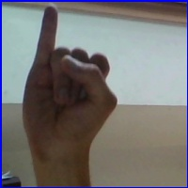
I

Slide 3
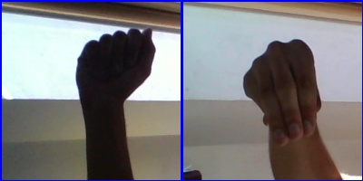
AM

Slide 4

KAMALESH

Slide 5
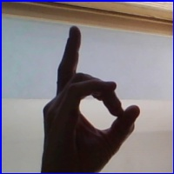
D

